Slide 1
Documentation-Driven Development
Notes:
Today’s topic

Slide 2
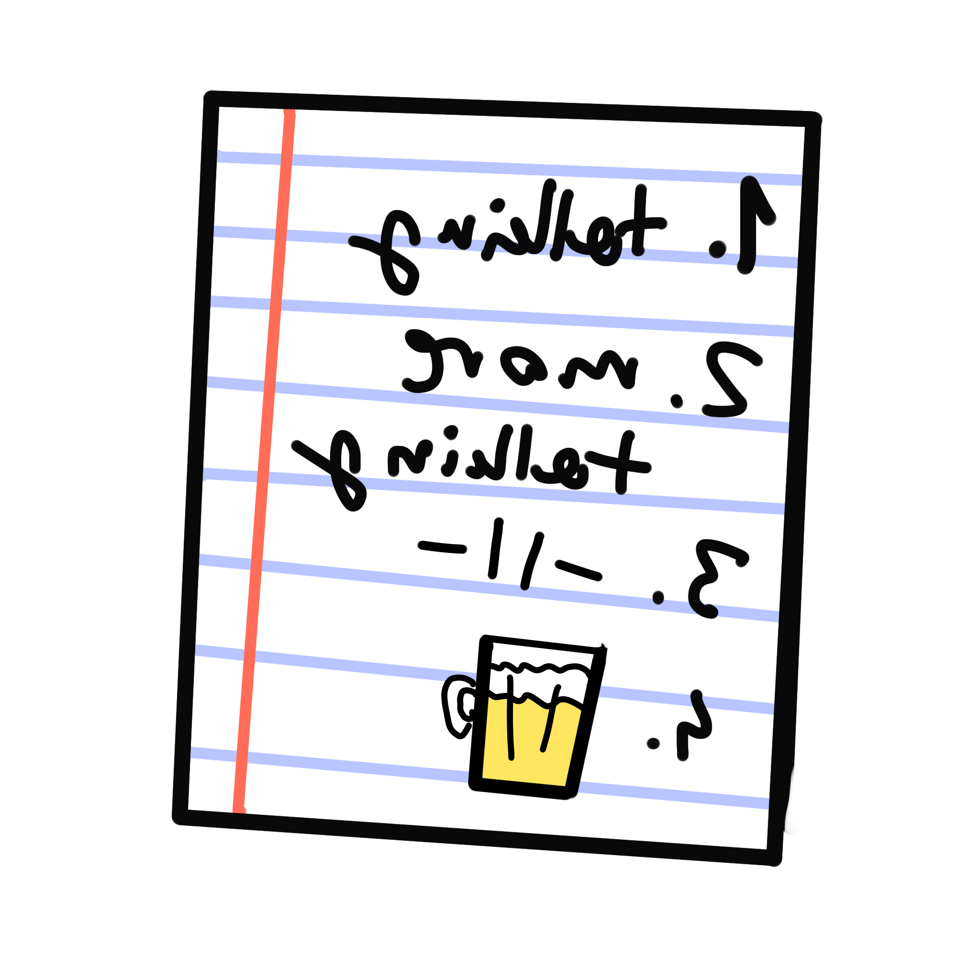
Agenda
Introduction
Three stories
Conclusion
Notes:
Agenda

Slide 3
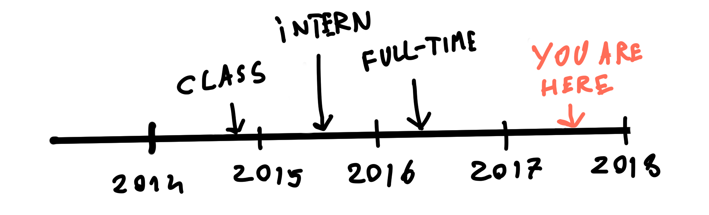
Quick introduction
Over two years ago: Introduction to Technical Writing (optional class)
Two years ago: Started my internship at Dassault Systemes
One year ago: Became a full-time technical writer
Notes:
How I begun my adventure as a technical writer
Introduction to technical writing at the university
Sounded interesting enough for me
At the time - thought that you can only be a translator or a teacher
I had no idea that there is a career in writing about software.

Slide 4
Official title:
User Assistance Developer
Contract says:
Autor Techniczny
Eng: Technical Author
Notes:
The official name of my role is “User Assistant Developer”
At first I did not like the developer part.
But after some time and after taking some courses I started creating tools for documentation.
The name on my contract says “Technical Author”
You can add that to the long list of names for technical writers.

Slide 5

Official title:
User Assistance Developer
Contract says:
Autor Techniczny
Technical Auteur?
Notes:
It sounds a bit fancy if you ask me...

Slide 6
Usual flow
feature/project planning
dev meetings
team meetings
end of feature/project
bonus stage - last minute changes in UI to mess with your screenshots
Notes:
Now here’s the usual flow for a project, iteration or a feature.
Project planning - what the project/feature is about
Dev meetings - how to implement it
Team meetings - implementing, documenting, testing
End of project/feature/iteration
And as a bonus - last minute changes to UI
Now usually, we don’t take part in the DEV meetings part
We’re not as technical etc.

Slide 7
1st story - new feature
New feature was to be implemented
Configuration was atrocious
People involved:
1 dev lead
2 devs
2 testers
Notes:
Now, I’m gonna tell you a story how I got involved more in development.
I was involved in this one project that worked on a mobile app with some offline capabilities.
In the team we had a project manager, one dev lead
We also had two devs which were concerned mostly on doing things on time
And two QAs testing application itself and how it communicated with the server.

Slide 8
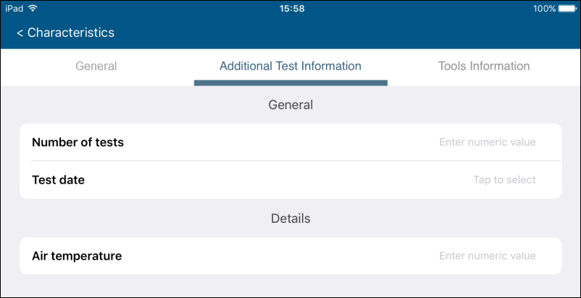
What was the feature about?
Defining screens with forms to fill out, for example:
Notes:
You might imagine a worker that has a list of tasks to perform, for example
A worker that is testing some piece of equipment and writing down results
The feature allowed for defining the screens with forms that had to be filled out.
Some of the fields could be of date type, text numbers, some could basically a switch
Also, drop-downs
Default values, required fields
The feature was about giving the user availability to add tabs with extra forms to fill out

Slide 9
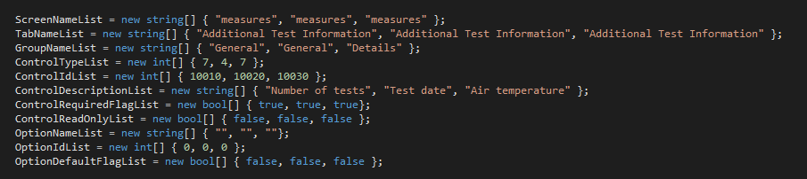
Configuration
Notes:
This is what the configuration looked like.
A bunch of arrays, each has to have the same number of elements.
It might not be that bad if you only one to add one tab with 3 fields to fill out,
But the basic scenarios had much more than that.
You have to repeat stuff over and over.
You wanted a dropdown list? You better make sure that those 20 positions in the middle of it all have correct values.
Good luck.
I tried it out myself - tried to configure a simple screen, I had to debug this configuration a couple of times.
You basically needed a huge spreadsheet for planning this sort of thing.
As you can imagine, this proved even harder to document.

Slide 10
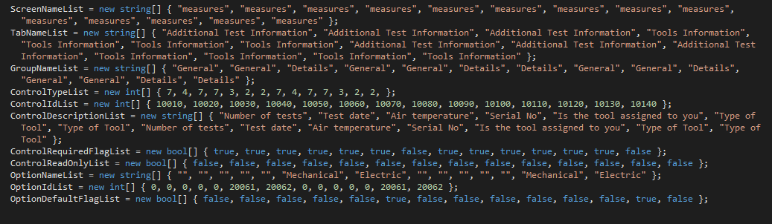
How to solve it?
Notes:
I took a closer look at this.
I realized that there is a structure in it,
A screen contained tabs, tabs contained groups, groups contained controls (fields)

Slide 11
A tree structure emerged...
Screen1
Tab 1
Group 1
Control 1
Control 2
Group 2
Control 3
Tab 2
Group 1
Control 1
Control 2
Notes:
A tree structure emerged.
We don’t need a flat list of items at all!
We can have a tree without the need to repeat ourselves.
Now I thought - this should be done in XML

Slide 12
... that could be translated to XML
Screen1
Tab 1
Group 1
Control 1
Control 2
Group 2
Control 3
Tab 2
Group 1
Control 1
Control 2
<Screen>
<Tab>
<Group>
<Control></Control>
<Control></Control>
</Group>
<Group>
<Control></Control>
</Group>
</Tab>
<Tab>
<Group>
<Control></Control>
<Control></Control>
</Group>
</Tab>
</Screen>
Notes:
So here is a simplified XML,
Things like names of the controls and default values etc. were done by adding attributes
Nothing had to be repeated. Everything was humanly readable.

Slide 13
XML mock-up
<Screen name=”measures”>
<Tab name=”Additional Test Information”>
<Group name=”General”>
<Control name=”Number of Tests” type=”7” id=”10”/>
<Control name=”Test date” type=”4” id=”20”/>
</Group>
<Group name=”Details”>
<Control name=”Air temperature” type=”7” id=”30”/>
</Group>
</Tab>
…
</Screen>
XML -> some code -> configuration
Notes:
I prepared a mock-up that looked a bit like this.
I showed this to the dev team.
I told them “see, this is more readable, this I can document”
All they had to do is write “some code” to transfer the XML into the configuration that the application expected.
So I started documenting, documenting based on my template XML. After a while - it was done

Slide 14
A few days passed...
And the “some code” part was still missing
Notes:
A few days pass and I ask the devs how they are doing,
Asked if they wrote the code that will parse this XML.
They wanted to finish this feature, move on to next tasks.
After all. It worked, didn’t it?
I got a bit cross.
So what did I do?

Slide 15
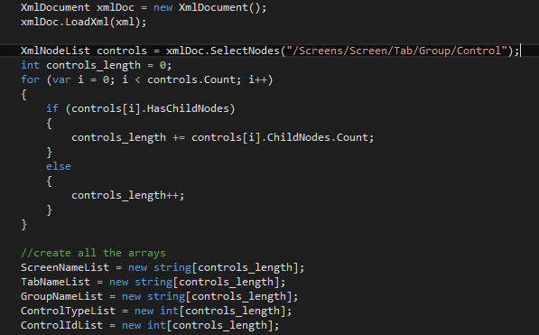
I wrote the code myself
Notes:
I wrote the code myself.
I was not going to settle on documenting something that was basically unusable.

Slide 16
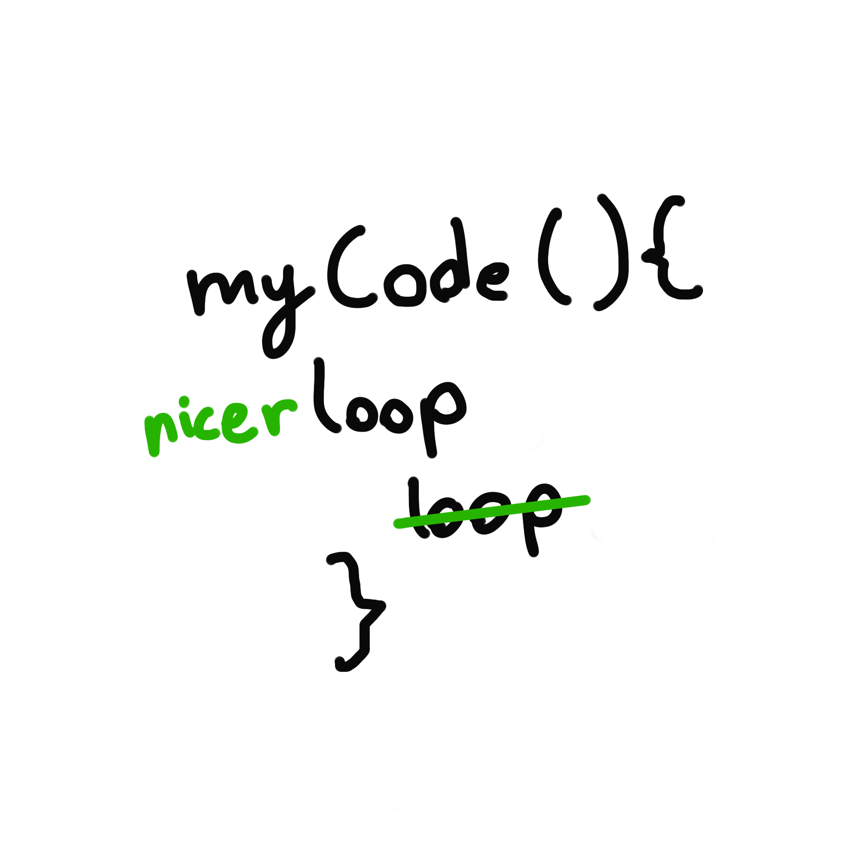
First code review!
Notes:
I wrote the code and tested it.
It was not perfect, but it still got the expected outcome.
So i went to one of the developers that happened to be free at the time, he was not involved in the project.
I showed him what I wrote and a few minutes later he came back.

Slide 17
Implementation
XML -> my code -> configuration
Notes:
I went back to the team and showed them what I did.
Once again they frowned, they obviously asked about the impact of this change.
Fortunately the QAs barely started testing the feature so they did not have to get used to this new way.

Slide 18
Pros
Already documented
Easier to configure
Easier to test
Free XML validation
No spreadsheet was harmed in the process!
Notes:
So I basically made configuration easier
I did not have to update my documentation
To the chagrin of developers this new way of configuring things helped QAs test the feature in more ways finding more bugs.
They could basically focus more on finding bugs in the functionality itself, rather than just debugging their configuration.
They could test adding as many tabs and groups as they wanted
Rainbows and all that.
When we got to the end of the project, I was commended by QAs for making their lives easier.

Slide 19
Do I have to become a developer?
Notice a problem early on in the development process
Don’t be afraid to voice your concerns
Find an ally
Notes:
You may ask yourself..
No absolutely not.
One thing that could have happened in this situation is that the developer that helped me could have written all the code and it would take them less time.
Usually, when we start a project the early meetings are only done among developers, because it’s too technical.
It is good to attend these meetings as well so we can spot problems early on.
What we can do is try to find an ally who cares about things like usability.
Sometimes as in my example you have to look outside the team, but you should keep looking.

Slide 20
2nd story - API documentation
Creating API documentation automatically
People involved:
1 technical writer who arranged the whole thing
1 dev who helped with infrastructure
1 dev who worked on a new API
Notes:
My second story is about how we started documenting APIs
This time apart from me 3 people were involved.
A technical writer (Magda) who wanted to automate API documentation (did research, arranged meetings)
1 dev who got involved into creating the flow for the whole thing
1 dev who was creating a new API
(I tricked developer into becoming a technical writer without him realizing it)

Slide 21
Example
/** * Logs a message in the console * @param {string} [type] info, warning or error * @param {string} [text] text of the message */ function logMessage(type, text){
… }
Notes:
Basically we needed a tool for creating documentation based on the code
and the comments in the code
We have a method or a function and a description saying what it does.
Saying what parameters each method needs

Slide 22
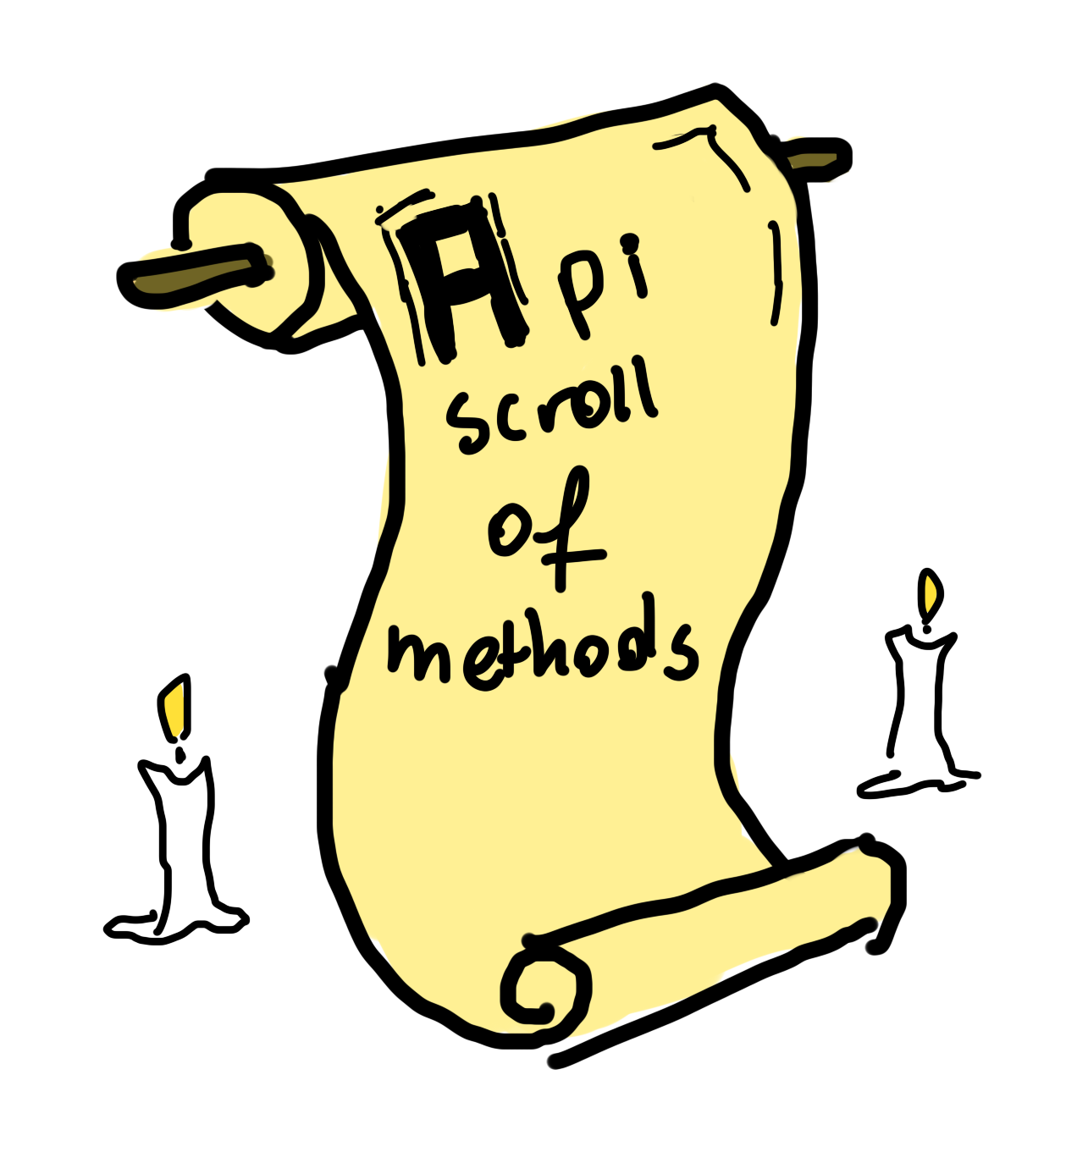
API documentation - dark ages
Code was commented and documentation was generated once
Documentation was written down once in markdown
APIs were both in JavaScript and TypeScript
Worst case scenario - no documentation
Notes:
At the time we basically had no way of generating this documentation automatically.
No automatic generation, which is ok for a product that’s not released that often, still

Slide 23
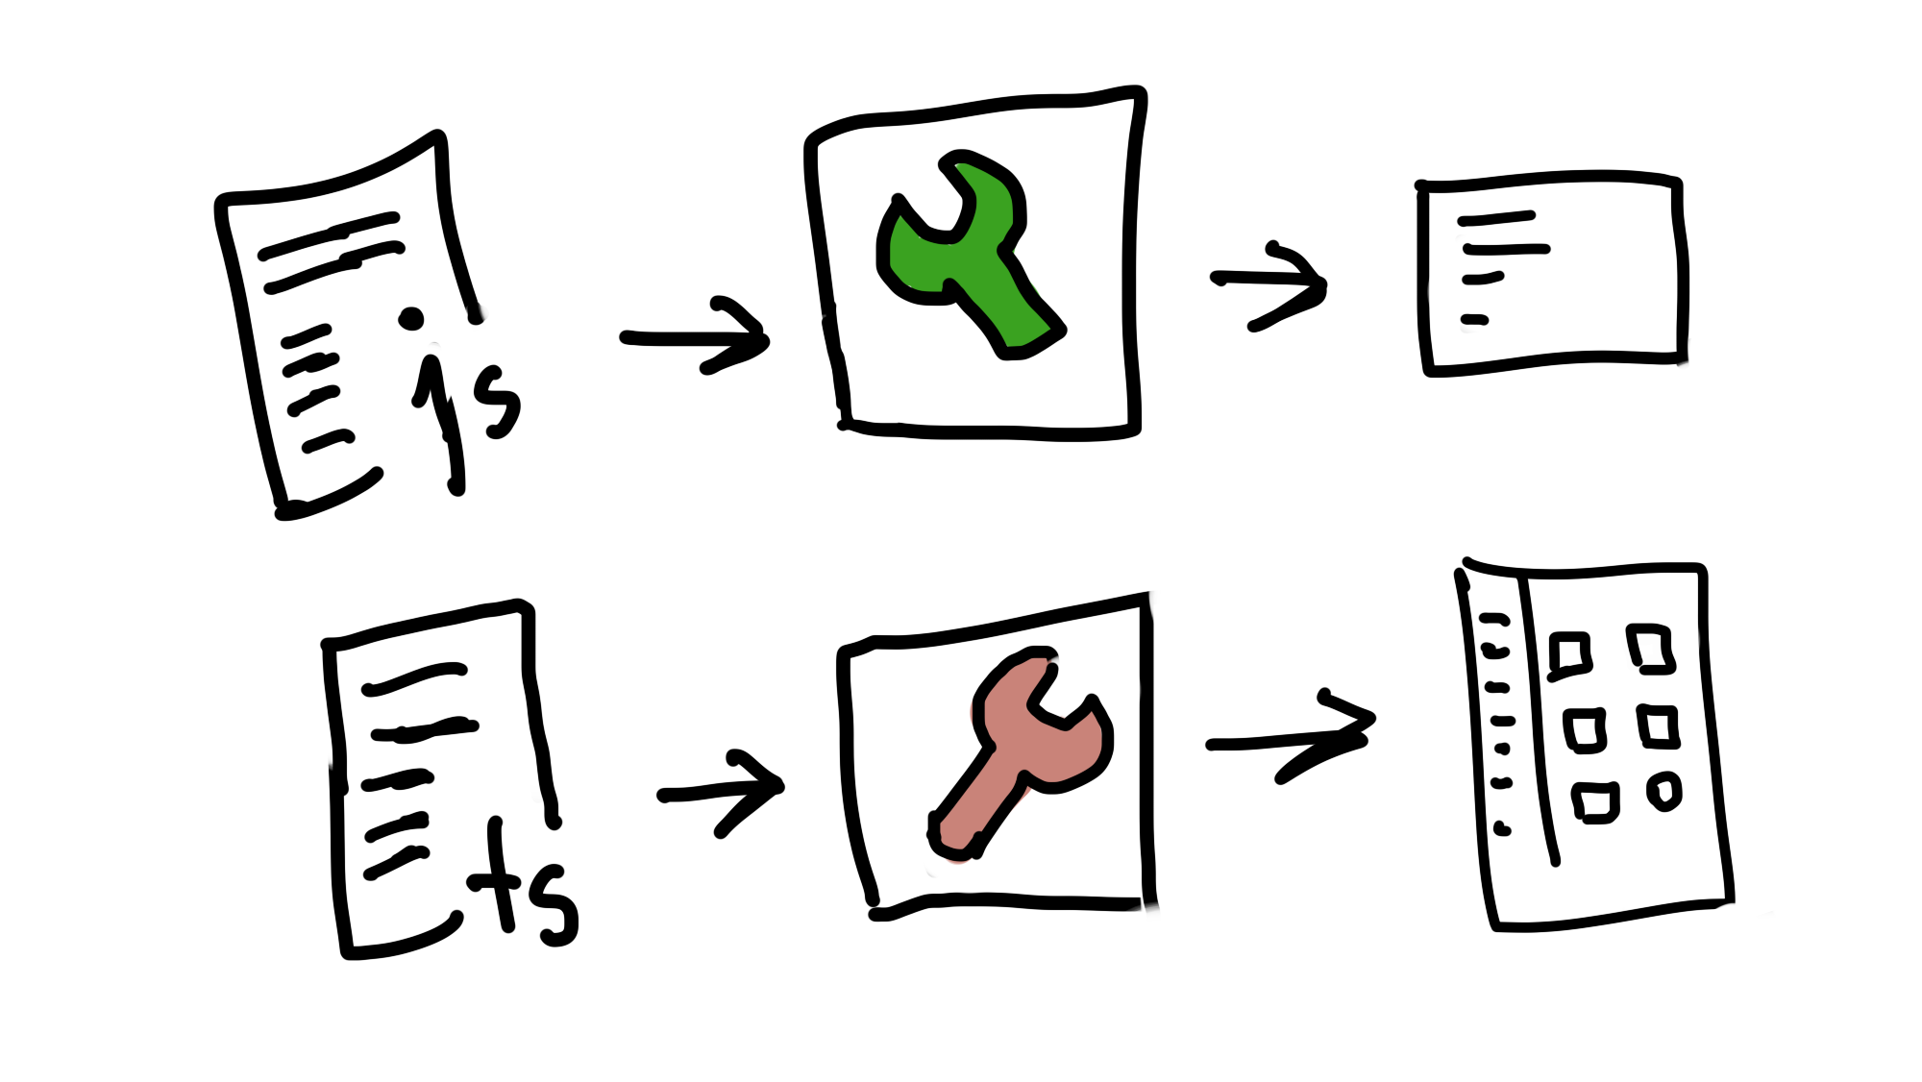
Issues
2 different outputs from two different tools
2 different tools had to be integrated with the documentation builds
Notes:
We had older APIs which were written in JavaScript and new APIs written in TypeScript.
The APIs we had documented were basically a list of functions.
At one point I thought ‘maybe all we need is one simple tool that would do both’
One tool that will look at the code and get .
At the time I didn’t really have much else to do so….

Slide 24
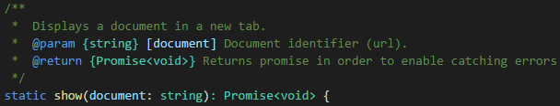
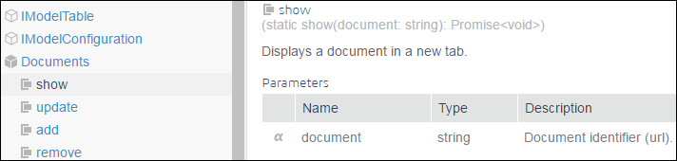
I wrote the code myself
Notes:
Now, I really wanted to get better at this programming thing and I saw that the documentation for api that we have is not that complicated
Plus, I had some free time on my hands so I basically created a tool for creating documentation from the code and the comments
I could have used 2 different programs for that, or if we only wanted to produce API documentation
I wanted to have full control over the output and be free to add new features easily

Slide 25
Reasons?
Opportunity to learn something new
Full control over the output
Easier integration
Notes:
Now, I really wanted to get better at this programming thing and I saw that the documentation for api that we have is not that complicated
Plus, I had some free time on my hands so I basically created a tool for creating documentation from the code and the comments
I could have used 2 different programs for that, or if we only wanted to produce API documentation
I wanted to have full control over the output and be free to add new features easily

Slide 26
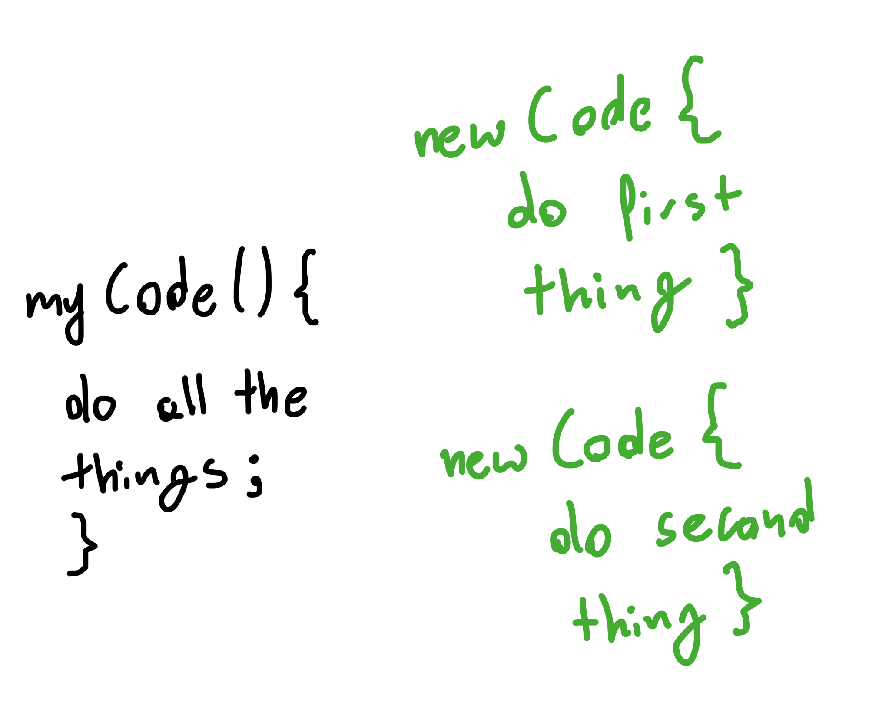
Second code review!
Notes:
This lead to another code review which taught me a few good practices
The code review was done by the developer doing the infrastructure
The developer told me to do the whole thing differently,
This actually helped me make the code more readable as well as easier to maintain
And add new features
If you want to hear about details we can talk later

Slide 27
Do I really have to become a developer?
Plenty of good tools for documenting databases, APIs, stylesheets
Easy to download and configure
With good documentation!
http://usejsdoc.org/
http://typedoc.org/
Notes:
Now you may ask yourself
No, not really.
There are plenty of open source tools for documenting anything from databases, through APIs written in various languages down to CSS classes.
Best of all,these tools have plenty of good documentation
The most important thing - I couldn’t have done it without the dev’s help

Slide 28
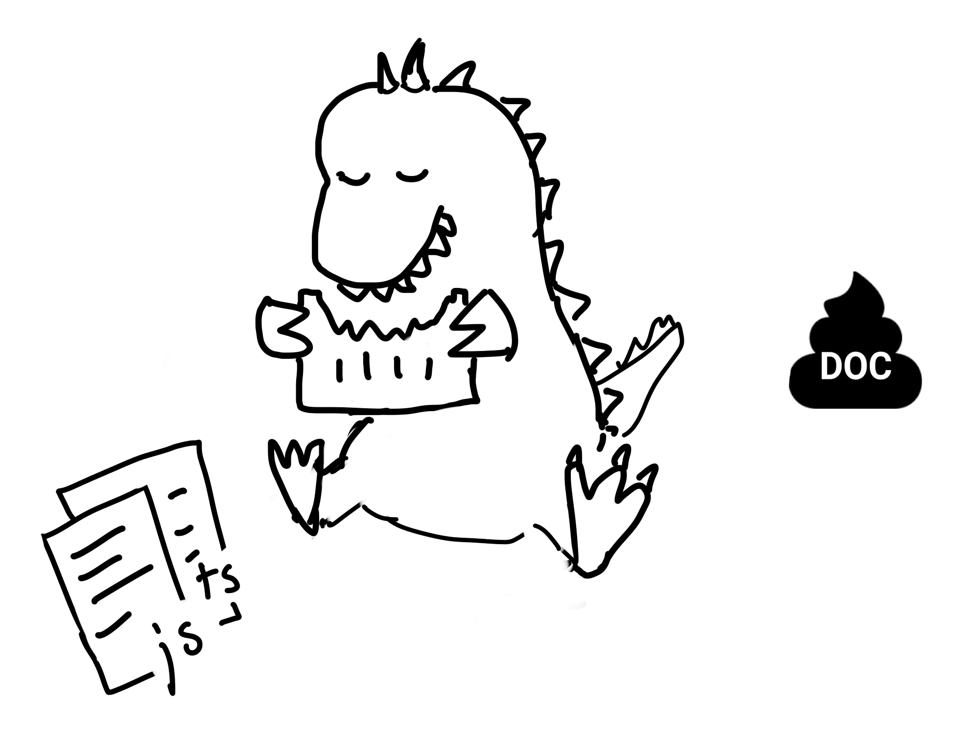
The API documentation flow
Writing code + comments -> tool -> output in web form
Notes:
So anyway, the tool was ready in its basic form and we had the flow prepared
The developer would write the code and comments and I would correct them.
Magic part is obviously the tool plus the whole infrastructure
And then we get the output in the web form.
This was ready just in time for when a new API was being introduced,

Slide 29
Dev’s questions
Who is this documentation for?
What format should I use for comments?
Can I use @[tag name]? I saw it in some other API documentation
How can I mark/group the more advanced stuff?
Are these names too similar?
Notes:
So anyway, the tool was ready in its basic form and we had the flow prepared
What was nice is the first question - who is this documentation for?
I told him to write comments for someone who knows how to write JS
The dev had some questions, he never wrote comments in the code, he did not know what format to use
I provided him with necessary examples.
He actually started adding more tags that were absent from the tool
He also asked whether we can mark certain functions as being more advanced -
He looked at the API documentation and asked about a way to mark the more advanced methods, or maybe even to group them separately.
I said sure - and I added it.
You could say that it was developer-driven-documentation-driven-development

Slide 30
Lessons learned
Find good tools
Establish a good flow
Settle on names early on
New features added to the tool to make documentation more readable:
Marking more advanced methods and grouping them together
Marking what error may appear if something goes wrong
Notes:
Here are the lessons that I and developers could learn along the way
At first, the methods available in the API were named similarly.
But just after generating the first documentation, the developer noticed something
The names were too similar, the developer knew that different methods did different things,
he saw in the code which were more complicated
Some things were really difficult to describe

Slide 31
Third story - the manual
A manual had to be written for a project (“offline apps”)
It was quite technical (framework + API + HTML and JS)
The manual was basically a tutorial of how to create an “offline app”
First draft done by a developer
People involved:
1 dev (same as the one who did the new API)
Notes:
I want to keep it short.
A developer had to write a manual.
The same developer that was working on it, it was for the same project
The manual was basically about creating ‘small apps’ with some offline capabilities using the new API and the product.
Unlike the previous one, it was more universal and mostly based on HTML and JavaScript.

Slide 32

More dev questions
Do you have a template manual?
Who is the user?
How detailed is this manual going to be?
Do I have to include examples?
What if my examples are too complicated?
Notes:
The developer asked questions like:
Who is the user? Who is this mythical creature that roams the manuals and helps
How detailed the manual was supposed to be?
There were certain procedures which were already documented
I told him that yes - we wanted examples, since this whole manual had to have some actual code snippets.
He started working on it, and really gotten into it.
at one point he realized that some examples were really hard to simplify…
He came across something that was hard to document, the product was missing something...

Slide 33
Something was hard to document...
In an easy way that is
Notes:
He found something that was too difficult to document
In a way that would be simple enough

Slide 34
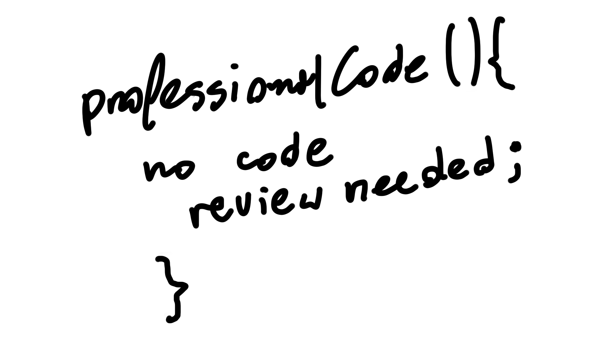
He wrote the code himself
Notes:
The developer actually changed the code of the product so he could create a simpler example.
Now without going into much detailed, the developer needed a type of variable that was absent from that one place in the product.
So he added it.

Slide 35
What did we learn?
Developers can write documentation too
There are types of documentation they like to write
They might even try to improve upon the first draft
Notes:
I guess there’s nothing new about this
But some developers are forced into writing documentation they don’t really want to
Or in a way that is not familiar to them
The difference this time was that they had to write documentation for someone who was not as technical as they are.

Slide 36
To sum up
Make developers aware that documentation exists and how it’s created
Show how changes in the software impact the documentation
Get more involved in the early stages of a project
Show others that making software easier to document is worth it
Get some developers more involved in the process of creating it
Choose the tools that the developers will want to use
Notes:
To sum up, here are the few things that we can do in order to get closer and closer to documentation-driven development (as I understand it at least)
Make developers aware that documentation exists - quite often devs at my work do not know how much of it is created automatically, and how much of it has to be maintained THey don’t know that comments in some parts of the code are actually used for documentation They don’t think about how certain things
Be involved in the planning stages of the project, raise
Get some of them involved,
As for the tools, I let developers decide what to use.
If they want to use markdown - that’s great, if they want to send me descriptions for verification
Finally, it’s good to listen to their feedback

Slide 37
Revised flow
feature/project planning - what terminology are we using?
dev meetings - what do we need to document and how?
team meetings - is documentation keeping up with development?
end of feature/project - how was documentation affected?
bonus stage - are we avoiding last-minute surprises?
Notes:
You remember the standard flow? Here is a revised flow
When we started the “offline app” project we actually started with settling on the names
The earlier we think about what sort of documentation we need the earlier we can ensure
That we can automate as much as we can

Slide 38

Thank you for listening!
Shameless plugs:
lotny.wordpress.com
github.com/lotny
Check out @thedocshit
Write about your technical-writing woes
Notes:
Thanks for listening

